Slide 1
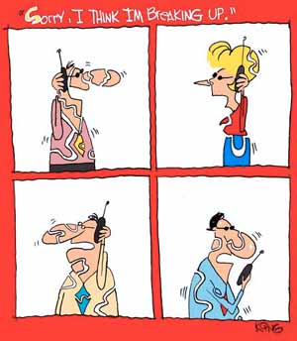
Path Loss, Shadowing, Fading Models
Signal Propagation Overview
Path Loss Models
  Free-space Path Loss
  Ray Tracing Models
  Simplified Path Loss Model
  Empirical Models

Slide 2

Propagation Characteristics
Propagation and noise effects are often collected and referred to as the channel.
Path Loss (includes average shadowing)
Shadowing (due to obstructions)
Multipath Fading
Slow
P_{r}/P_{t}
Fast
Very slow
P_{t}
P_{r}
v
d=vt
d=vt

Slide 3
Path Loss Modeling
Maxwell’s equations
  Complex and impractical
Free space path loss model
  Too simple
Ray tracing models
  Requires site-specific information
Empirical Models
  Don’t always generalize to other environments
Simplified power falloff models
  Main characteristics: good for high-level analysis

Slide 4
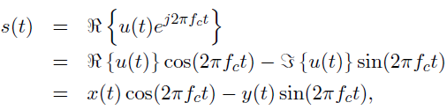

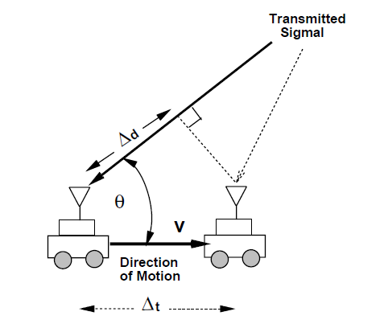



Signal Models
Tx signal
Rx signal
Doppler shift
Path loss

Slide 5
Free Space (LOS) Model
d=vt
Path loss for unobstructed LOS path
Power falls off :
  Proportional to d²
  Proportional to λ² (inversely proportional to f²)

Slide 6



Free-Space Path Loss
Isotropic antenna txs equally in all directions
Rx signal
Power loss

Slide 7
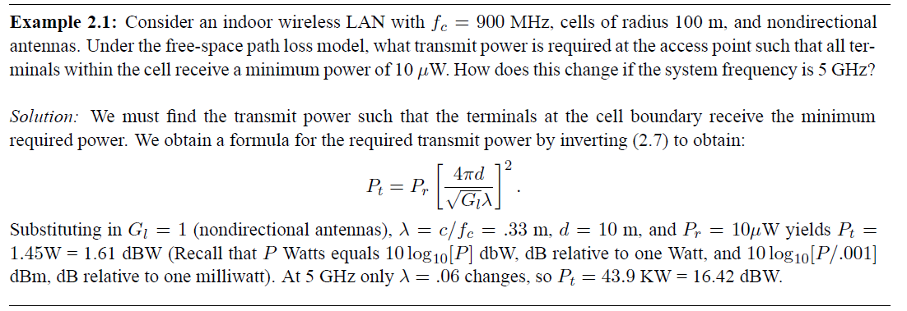
Example

Slide 8
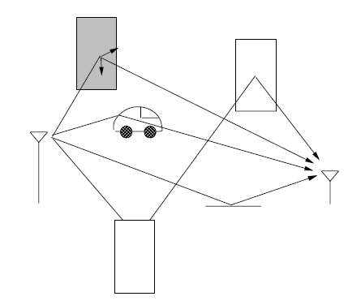
Ray Tracing Approximation
Represent wavefronts as simple particles
Geometry determines received signal from each signal component
Typically includes reflected rays, can also include scattered and defracted rays.
Requires site parameters
  Geometry
  Dielectric properties

Slide 9
Two Path Model
Path loss for one LOS path and 1 ground (or reflected) bounce
Ground bounce approximately cancels LOS path above critical distance
Power falls off
  Proportional to d² (small d)
  Proportional to d⁴ (d>d_{c})
  Independent of λ (f)

Slide 10
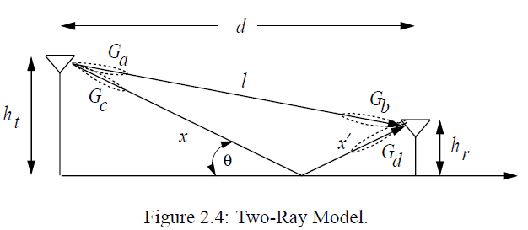


Terrestrial Propagation

Slide 11





Pass Loss
Dist. difference
Taylor approx.
Reflection
For large d:

Slide 12
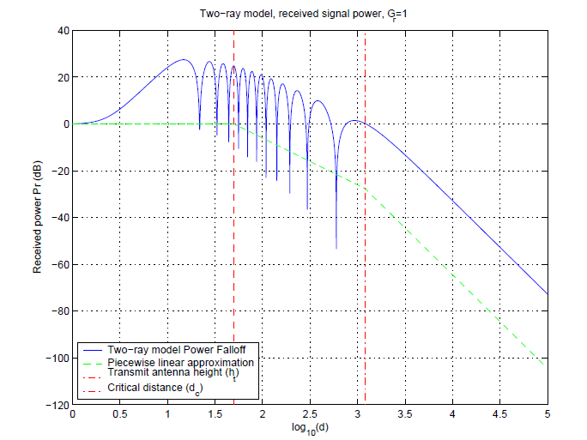
Two-Ray Received Power
Critical distance:

Slide 13
Two-Ray Equation
It differs from free-space equation in 3 ways:
  With R>>h_{T}, h_{R}, it’s frequency independent.
  It shows an inverse fourth-power law.
  It shows dependence on antenna height.
An minor difference in the model can make a significant change in radio propagation.

Slide 14
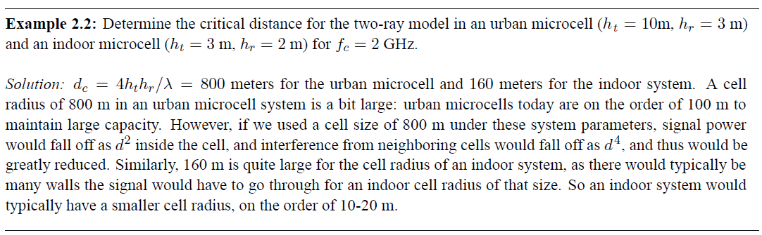
Example

Slide 15

General Ray Tracing
Models all signal components
  Reflections
  Scattering
  Diffraction
Requires detailed geometry and dielectric properties of site
  Similar to Maxwell, but easier math.
Computer packages often used

Slide 16
Empirical Models
Okumura model
  Empirically based (site/freq specific)
  Awkward (uses graphs)
Hata model
  Analytical approximation to Okumura model
Cost 136 Model:
  Extends Hata model to higher frequency (2 GHz)
Commonly used in cellular system simulations

Slide 17
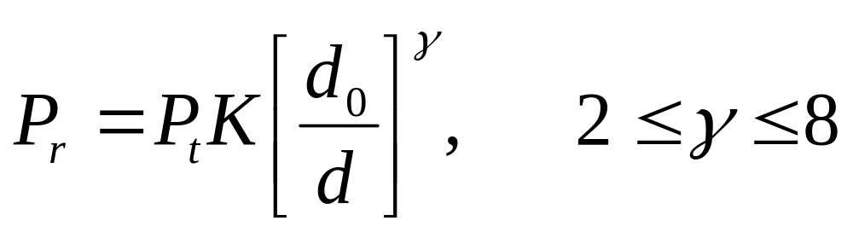
Simplified Path Loss Model
Used when path loss dominated by reflections.
Most important parameter is the path loss exponent γ, determined empirically.

Slide 18
Main Points
Path loss models simplify Maxwell’s equations
Models vary in complexity and accuracy
Power falloff with distance is proportional to d² in free space, d⁴ in two path model
General ray tracing computationally complex
Empirical models used in 2G simulations
Main characteristics of path loss captured in simple model P_{r}=P_{t}K[d₀/d]^{γ}

Slide 19


Shadowing
X_{c}
Models attenuation from obstructions
Random due to random # and type of obstructions
Typically follows a log-normal distribution
  dB value of power is normally distributed
  μ=0 (mean captured in path loss), 4<σ²<12 (empirical)
  LLN used to explain this model
  Decorrelated over decorrelation distance X_{c}

Slide 20
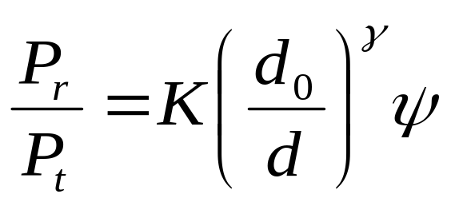
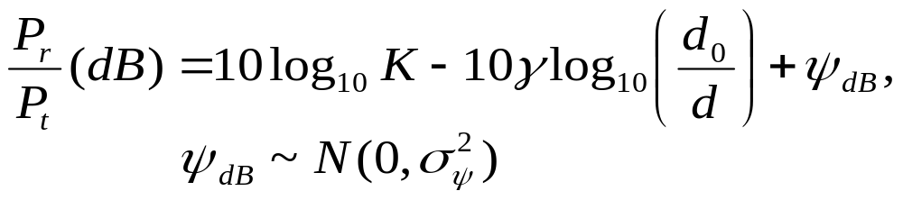
Combined Path Loss and Shadowing
Linear Model: ψ lognormal
dB Model
10logΚ
Slow
P_{r}/P_{t}
(dB)
Very slow
-10γ
log d

Slide 21

Outage Probability and Cell Coverage Area
Path loss: circular cells
Path loss+shadowing: amoeba cells
  Tradeoff between coverage and interference
Outage probability
  Probability received power below given minimum
Cell coverage area
  % of cell locations at desired power
  Increases as shadowing variance decreases
  Large % indicates interference to other cells

Slide 22

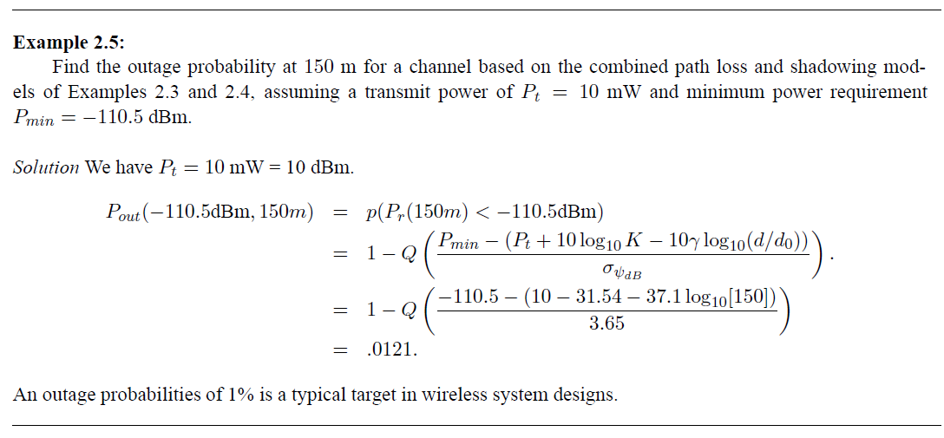
Outage Probability under Pass Loss and Shadowing

Slide 23





Cell Coverage Area
Rx power at cell boundary

Slide 24
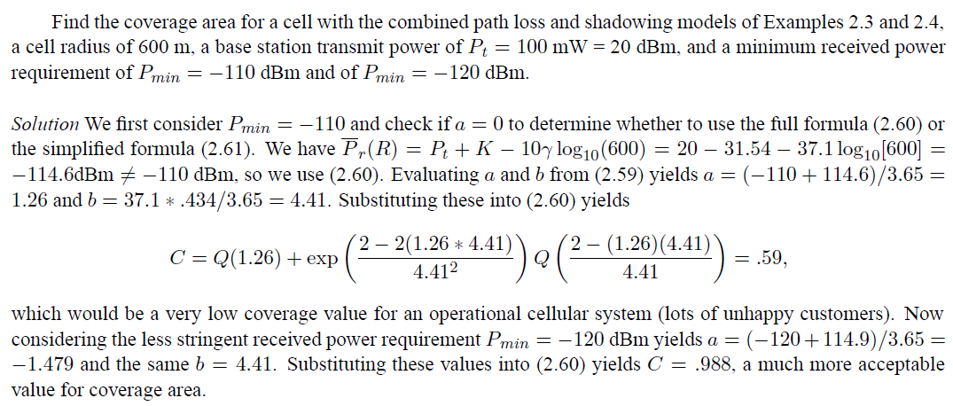
Cell Coverage Area Example

Slide 25
Model Parameters from
Empirical Measurements
K (dB)
2
σ_{ψ}
P_{r}(dB)
Fit model to data
Path loss (K,γ), d₀ known:
  “Best fit” line through dB data
  K obtained from measurements at d₀.
  Exponent is MMSE estimate based on data
  Captures mean due to shadowing
Shadowing variance
  Variance of data relative to path loss model (straight line) with MMSE estimate for γ
10γ
log(d)
log(d₀)

Slide 26
Main Points
Random attenuation due to shadowing modeled as log-normal (empirical parameters)
Shadowing decorrelates over decorrelation distance
Combined path loss and shadowing leads to outage and amoeba-like cell shapes
Cellular coverage area dictates the percentage of locations within a cell that are not in outage
Path loss and shadowing parameters are obtained from empirical measurements

Slide 27
Statistical Multipath Model
Random # of multipath components, each with
  Random amplitude
  Random phase
  Random Doppler shift
  Random delay
Random components change with time
Leads to time-varying channel impulse response

Slide 28
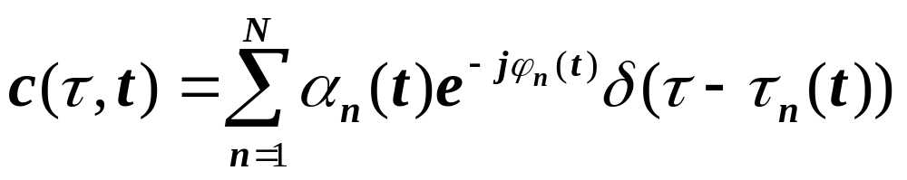
Time Varying Impulse Response
Response of channel at t to impulse at t-τ:
  t is time when impulse response is observed
  t-τ is time when impulse put into the channel
  τ is how long ago impulse was put into the channel for the current observation
    path delay for MP component currently observed

Slide 29
Received Signal Characteristics
Received signal consists of many multipath components
Amplitudes change slowly
Phases change rapidly
  Constructive and destructive addition of signal components
  Amplitude fading of received signal (both wideband and narrowband signals)

Slide 30
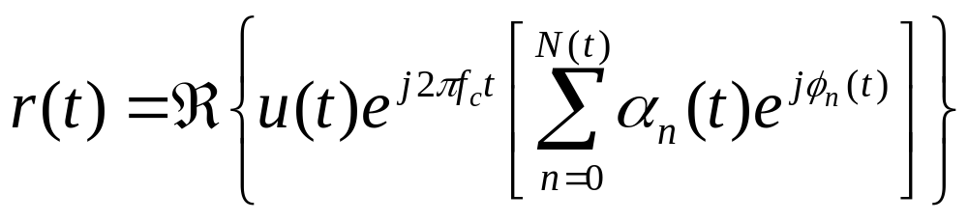
Narrowband Model
Assume delay spread max_{m,n}|τ_{n}(t)-τ_{m}(t)|<<1/B
Then u(t)≈u(t-τ).
Received signal given by
No signal distortion (spreading in time)
Multipath affects complex scale factor in brackets.
Characterize scale factor by setting u(t)=δ(t)

Slide 31
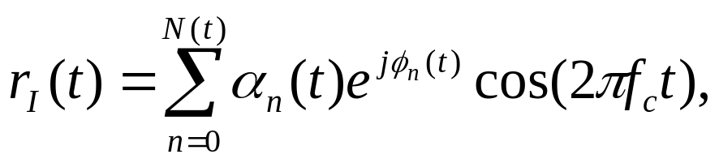
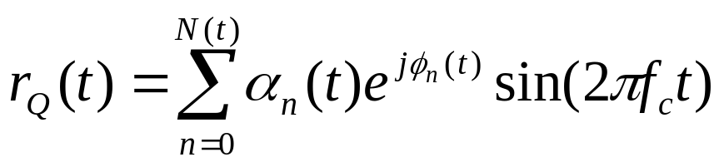
In-Phase and Quadrature under CLT Approximation
In phase and quadrature signal components:
For N(t) large, r_{I}(t) and r_{Q}(t) jointly Gaussian (sum of large # of random vars).
Received signal characterized by its mean, autocorrelation, and cross correlation.
If ϕ_{n}(t) uniform, the in-phase/quad components are mean zero, indep., and stationary.

Slide 32
Main Points
Statistical multipath model leads to a time-varying channel impulse response
Received signal has random amplitude fluctuations
Narrowband model and CLT lead to in-phase/quad components that are stationary Gaussian processes
  Processes completely characterized by their mean, autocorrelation, and cross correlation.
Assuming uniform phase offsets, process is zero mean with joint expectation also zero.

Slide 33
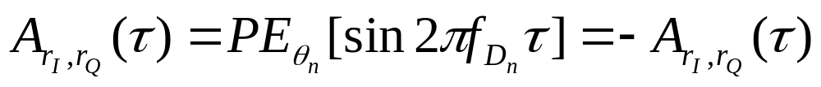
Auto and Cross Correlation
Assume φ_{n}~U[0,2π]
Recall that θ_{n} is the multipath arrival angle
Autocorrelation of inphase/quad signal is
Cross Correlation of inphase/quad signal is
Autocorrelation of received signal is

Slide 34
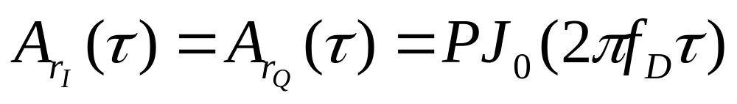
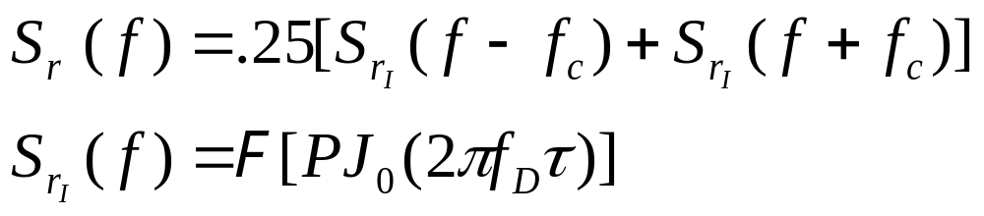
Uniform AOAs
Under uniform scattering, in phase and quad comps have no cross correlation and autocorrelation is
The PSD of received signal is
Decorrelates over roughly half a wavelength
S_{r}(f)
Used to generate simulation values
f_{c}-f_{D}
f_{c}
f_{c}+f_{D}

Slide 35
Main Points
Narrowband model has in-phase and quad. comps that are zero-mean stationary Gaussian processes
  Auto and cross correlation depends on AOAs of multipath
Uniform scattering makes autocorrelation of inphase and quad follow Bessel function
  Signal components decorrelate over half wavelength
  Cross correlation is zero (in-phase/quadrature indep.)
The power spectral density of the received signal has a bowel shape centered at carrier frequency
  PSD useful in simulating fading channels

Slide 36
Signal Envelope Distribution
CLT approx. leads to Rayleigh distribution (power is exponential)
When LOS component present, Ricean distribution is used
Measurements support Nakagami distribution in some environments
  Similar to Ricean, but models “worse than Rayleigh”
  Lends itself better to closed form BER expressions

Slide 37




Wideband Channels
Individual multipath components resolvable
True when time difference between components exceeds signal bandwidth
τ
τ
Narrowband
Wideband

Slide 38
Scattering Function
Fourier transform of c(τ,t) relative to t
Typically characterize its statistics, since c(τ,t) is different in different environments
Underlying process WSS and Gaussian, so only characterize mean (0) and correlation
Autocorrelation is A_{c}(τ₁,τ₂,Δt)=A_{c}(τ,Δt)
Statistical scattering function:
s(τ,ρ)=F_{Δt}[A_{c}(τ,Δt)]
ρ
τ

Slide 39


Multipath Intensity Profile
A_{c}(τ)
T_{M}
Defined as A_{c}(τ,Δt=0)= A_{c}(τ)
  Determines average (T_{M} ) and rms (σ_{τ}) delay spread
  Approximate max delay of significant m.p.
Coherence bandwidth B_{c}=1/T_{M}
  Maximum frequency over which A_{c}(Δf)=F[A_{c}(τ)]>0
  A_{c}(Δf)=0 implies signals separated in frequency by Δf will be uncorrelated after passing through channel
τ
A_{c}(f)
τ
0
Bc
f

Slide 40
Doppler Power Spectrum
S_{c}(ρ)
ρ
B_{d}
S_{c}(ρ)=F[A_{c}(τ=0,Δt)]= F[A_{c}(Δt)]
Doppler spread B_{d} is maximum doppler for which S_{c} (ρ)=>0.
Coherence time T_{c}=1/B_{d}
  Maximum time over which A_{c}(Δt)>0
  A_{c}(Δt)=0 implies signals separated in time by Δt will be uncorrelated after passing through channel

Slide 41
Main Points
Scattering function characterizes rms delay and Doppler spread. Key parameters for system design.
Delay spread defines maximum delay of significant multipath components. Inverse is coherence bandwidth of channel
Doppler spread defines maximum nonzero doppler, its inverse is coherence time

